Slide 1
HPV & Dysplasia
Pre-Lecture Summary

Slide 2
Objectives
Discuss the epidemiology and molecular biology of HPV.
Describe the clinical presentations of HPV infection.
Identify histologic and cytologic features of HPV.
Distinguish between HPV and differential diagnoses.

Slide 3
HPV Infections
HPV: small DNA viruses with 200+ subtypes.
Cause warts, intraepithelial, and invasive squamous lesions.

Slide 4
HPV Types & Diseases
Low-risk: Types 6, 11.
High-risk: Types 16, 18, 31, 33, 35, 45, 52 & 58
Diseases: CIN, VIN, PIN, AIN, squamous cell carcinoma.

Slide 5
Cells Infected by HPV
Targets: Anogenital tract, oral cavity, and metaplastic cells in the transformation zone.

Slide 6
Epidemiology of HPV Infection
Peak incidence: Late teens to 30%.
Risk factors: Multiple partners, immune status.
Majority of infections regress without therapy.

Slide 7
Clinical Lesions Caused by HPV
Common warts, condyloma acuminatum, LSIL, HSIL, squamous cell carcinoma.

Slide 8
Diagnostics of HPV
Clinical exams, colposcopy, pathology.
Biopsy, cytology, molecular methods.

Slide 9
Genetics of HPV
E6 gene: Interferes with p53.
E7 gene: Interferes with Rb.
Leads to uncontrolled transcription and DNA repair issues.

Slide 10
Methods of Treatment
Keratolytic agents, cryo, laser therapy, LEEP, immunotherapy.

Slide 11
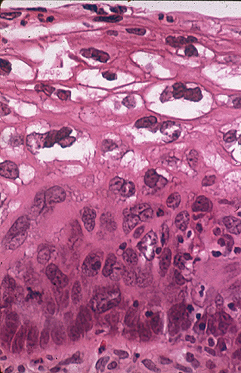
Histologic Presentation of HPV
Types: Flat, Proliferative, Inverted.
Common features: Koilocytosis, parakeratosis, dyskeratosis.

Slide 12
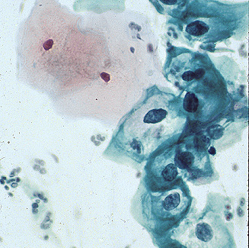
Cytology
Cytoplasmic changes: Koilocytosis, hyperkeratosis.
Nuclear changes: Hyperchromasia, irregular membrane.

Slide 13
Differential Diagnosis of HPV
Inflammatory/degenerative, glycogen deposits, radiation changes.

Slide 14
Morphologic Variants of HPV
Keratinizing and nonkeratinizing dysplasia.
Variants include pleomorphic squamous cells with dyskeratotic cytoplasm.

