Slide 1
The Bethesda System for Reporting Cervical Cytology
A Guide for Pathologists

Slide 2
Introduction to the Bethesda System
Standardized system for cervical cytology reporting.
Developed to provide uniform diagnostic terminology and enhance communication.

Slide 3
Objectives
Improve the clarity and consistency of cervical cytology reports.
Facilitate better patient management and follow-up.

Slide 4
Sample Adequacy
Satisfactory for evaluation
Adequate number of well visualized or preserved squamous or squamous metaplastic cells
Conventional smear: minimum of 8,000 to 12,000 cells
Liquid based preparation: minimum of 5,000 cells
Woman's postchemotherapy, radiotherapy, postmenopausal, atrophic changes or posthysterectomy may have < 5,000 cells and be deemed adequate at laboratory's discretion (if > 2,000 cells)
Exception: adequate if any abnormal cells are present

Slide 5
Sample Adequacy
Quality indicators:
Presence or absence of endocervical or transformation zone component
At least 10 well preserved endocervical or metaplastic cells
Absence of transformation zone does not necessitate repeat testing

Slide 6
General Categorization
Negative for Intraepithelial Lesion or Malignancy (NILM).
Epithelial Cell Abnormalities.
Other: Endometrial cells (in women = 45 years).

Slide 7
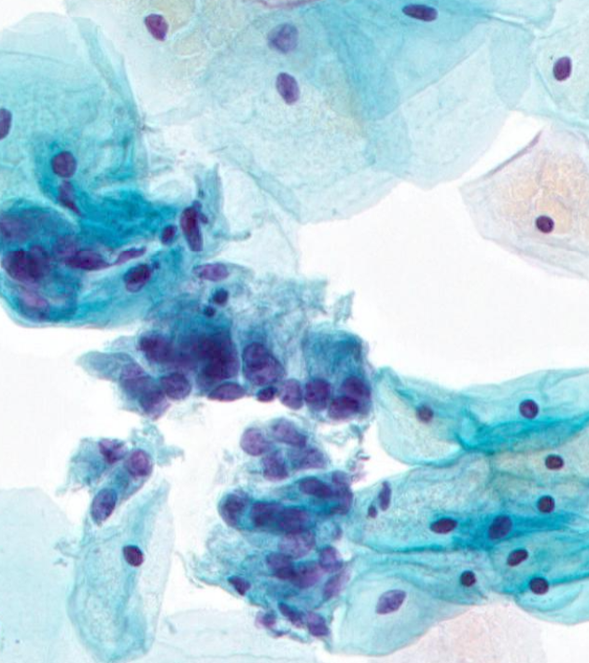
NILM (Negative for Intraepithelial Lesion or Malignancy)
No evidence of intraepithelial lesion or malignancy.
Includes benign cellular changes such as reactive and reparative changes.

Slide 8
Epithelial Cell Abnormalities
Classified as Squamous or Glandular.
Squamous: ASC, LSIL, HSIL, SCC.
Glandular: AGC, AIS, Adenocarcinoma.

Slide 9
Squamous Cell Abnormalities
ASC: Atypical Squamous Cells.
LSIL: Low-Grade Squamous Intraepithelial Lesion.
HSIL: High-Grade Squamous Intraepithelial Lesion.
SCC: Squamous Cell Carcinoma.

Slide 10
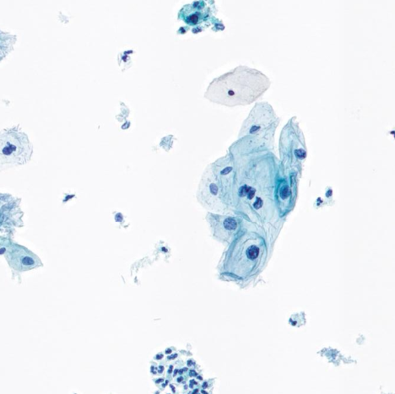
Atypical Squamous Cells (ASC)
ASC-US: Undetermined significance.

Slide 11
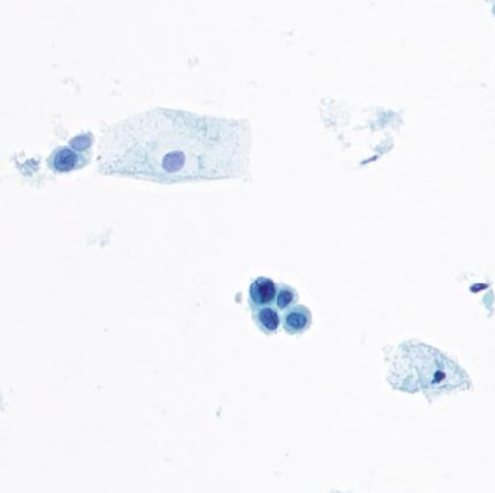
Atypical Squamous Cells (ASC)
ASC-H: Cannot exclude HSIL.

Slide 12
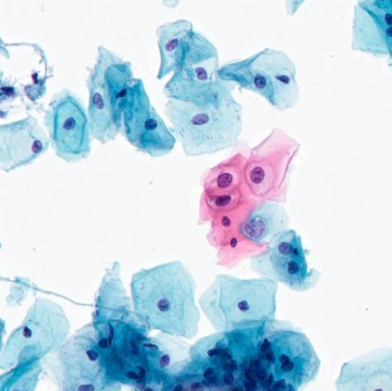
Low-Grade Squamous Intraepithelial Lesion (LSIL)
Mild dysplasia/CIN 1.
Associated with HPV infection.

Slide 13
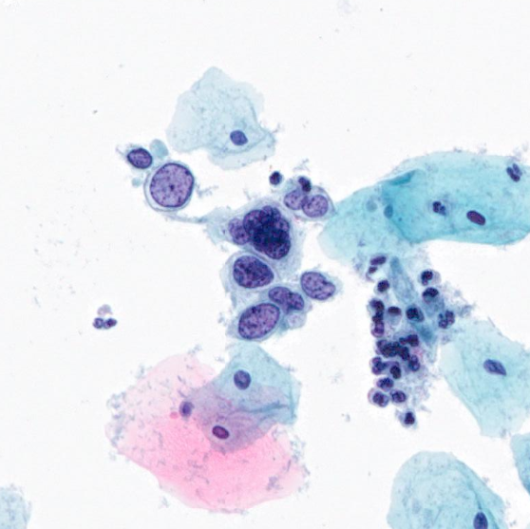
High-Grade Squamous Intraepithelial Lesion (HSIL)
Moderate to severe dysplasia/CIN 2, CIN 3.
Increased risk for progression to invasive cancer.

Slide 14
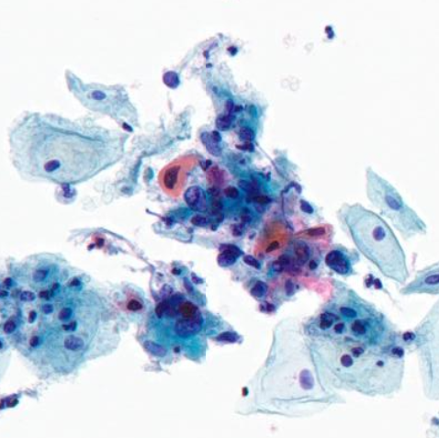
Squamous Cell Carcinoma (SCC)
Invasive squamous cell carcinoma.
Requires immediate clinical management.

Slide 15
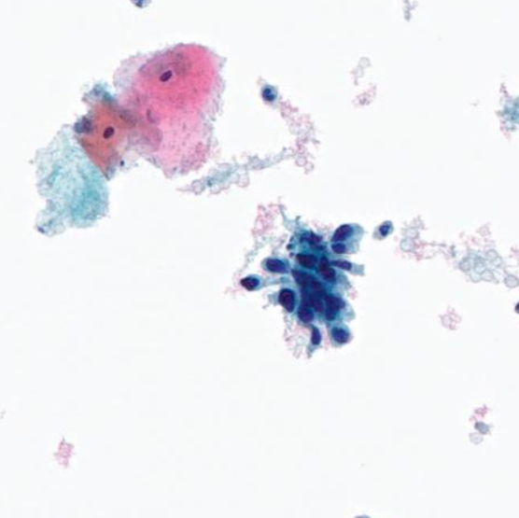
Glandular Cell Abnormalities
AGC: Atypical Glandular Cells.

Slide 16
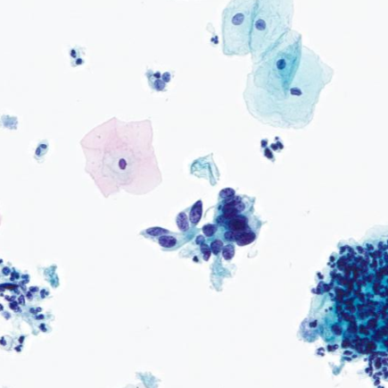
Glandular Cell Abnormalities
AIS: Adenocarcinoma In Situ.

Slide 17
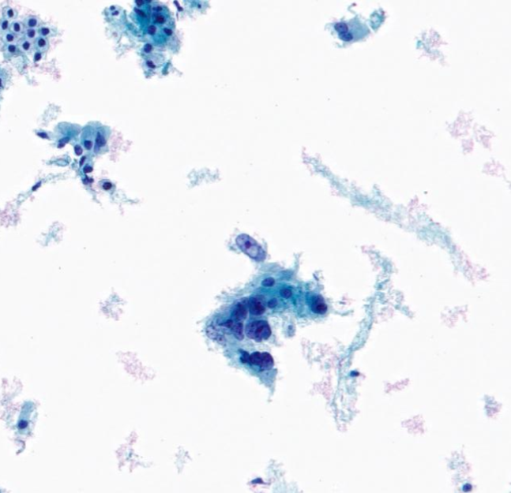
Glandular Cell Abnormalities
Adenocarcinoma: Invasive glandular carcinoma.

Slide 18
Management Recommendations
Based on cytological findings and clinical guidelines.
Includes follow-up testing, colposcopy, and treatment.

Slide 19
Conclusion
The Bethesda System standardizes cervical cytology reporting.
Enhances communication between laboratories and clinicians.
Aids in the management and treatment of cervical abnormalities.

